Slide 1
Multistage Pipeline RISC-V Core

Slide 2
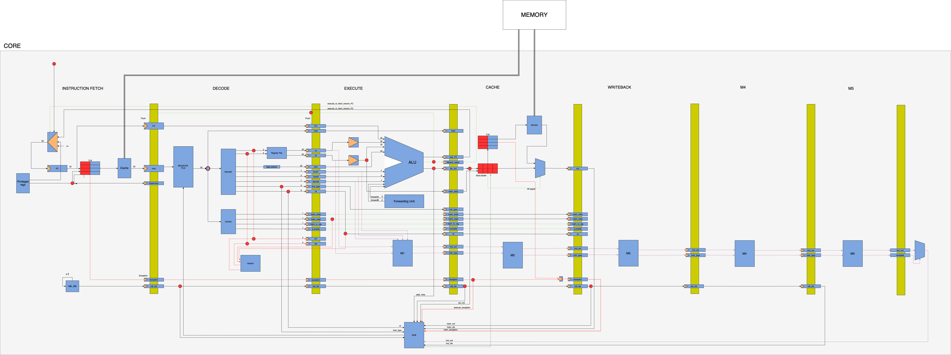

Slide 3
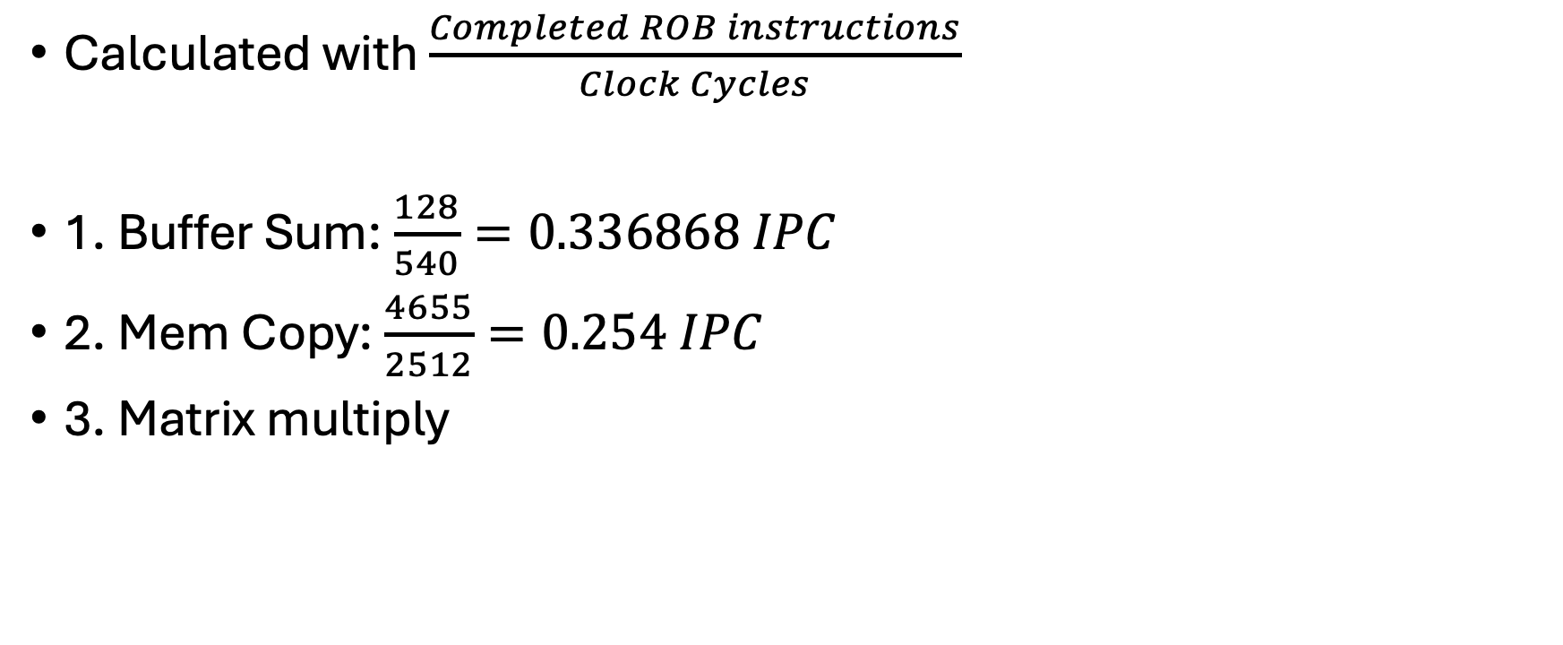
Performance metrics
Calculated with $\frac{Completed ROB instructions}{Clock Cycles}$
1. Buffer Sum: $\frac{128}{540}=0.336868 IPC$
2. Mem Copy: $\frac{4655}{2512}=0.254 IPC$
3. Matrix multiply

